Slide 1
Approximations and Round-Off Errors Chapter 3

Slide 2
Error Definitions
True error: E_{t} = True value – Approximation (+/-)
Approximate Error
For numerical methods, the true value will be known only when we deal with functions that can be solved analytically.
In real world applications, we usually do not know the answer a priori.
Approximate Error = CurrentApproximation(i) – PreviousApproximation(i-1)

Slide 3
Iterative approaches
Computations are repeated until stopping criterion is satisfied
Pre-specified % tolerance based on your knowledge of the solution. (Use absolute value)
If ε_{s} is chosen as:
Then the result is correct to at least n significant figures (Scarborough 1966)

Slide 4
EXAMPLE 3.2: Maclaurin series expansion
Calculate e^{0.5} (= 1.648721…) up to 3 significant figures. During the calculation process, compute the true and approximate percent relative errors at each step
Error tolerance
Terms
1
1+(0.5)
1+(.5)+(.5)²/2
1+(.5)+(.5)²/2+(.5)³/6
Count | Result | ε_{t} (%) True | ε_{a} (%) Approx.
1 | 1 | 39.3
2 | 1.5 | 9.02 | 33.3
3 | 1.625 | 1.44 | 7.69
4 | 1.6458333 | 0.175 | 1.27
5 | 1.6484375 | 0.0172 | 0.158
6 | 1.648697917 | 0.00142 | 0.0158

Slide 5
Round-off and Chopping Errors
Numbers such as π, e, or √7 cannot be expressed by a fixed number of significant figures. Therefore, they can not be represented exactly by a computer which has a fixed word-length
π = 3.1415926535….
Discrepancy introduced by this omission of significant figures is called round-off or chopping errors.
If π is to be stored on a base-10 system carrying 7 significant digits,
chopping : π=3.141592 error: ε_{t}=0.00000065
round-off: π=3.141593 error: ε_{t}=0.00000035
Some machines use chopping, because rounding has additional computational overhead.

Slide 6
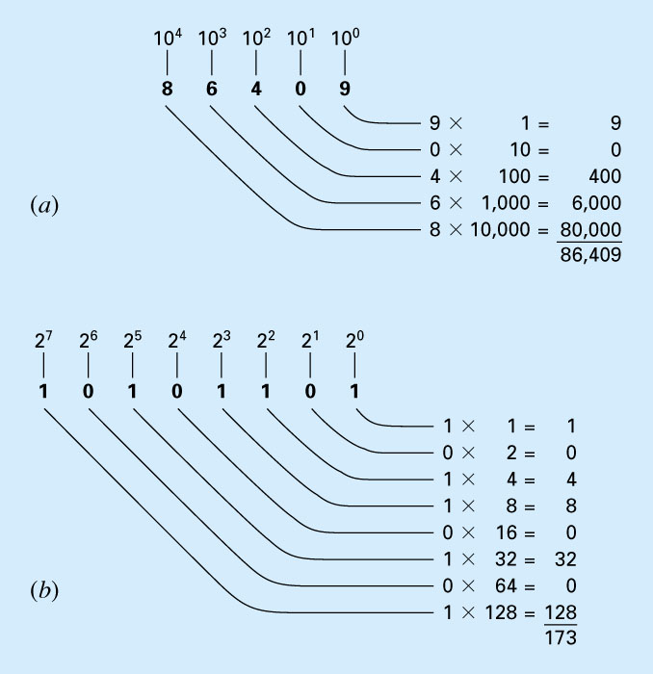
Number Representation 86409 in Base-10
173 in Base-2

Slide 7
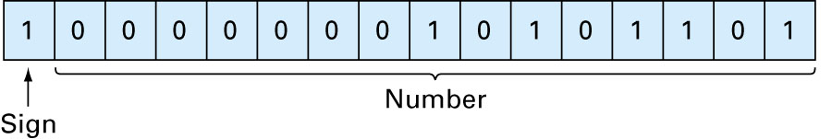
The representation of -173 on a 16-bit computer using the signed magnitude method

Slide 8
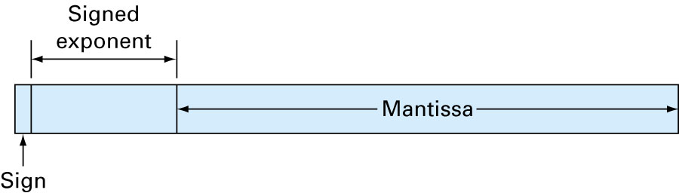
Computer representation of a floating-point number
exponent
mantissa
Base of the number system used

Slide 9
156.78    0.15678x10³
(in a floating point base-10 system)
Suppose only 4 decimal places to be stored
Normalize ➔ remove the leading zeroes.
Multiply the mantissa by 10 and lower the exponent by 1
0.2941 x 10⁻¹
Additional significant figure is retained

Slide 10
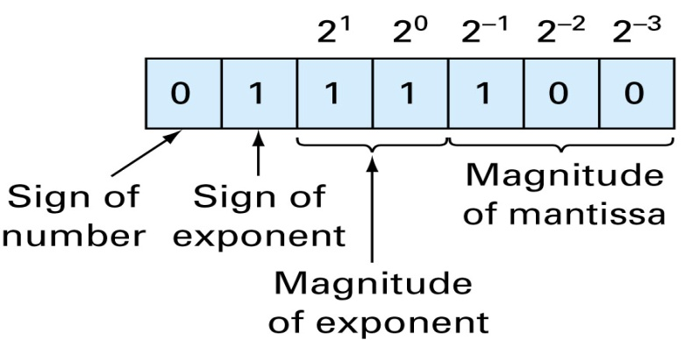
Due to Normalization, absolute value of m is limited:
for base-10 system: 0.1 ≤ m < 1
for base-2 system: 0.5 ≤ m < 1
Floating point representation allows both fractions and very large numbers to be expressed on the computer. However,
Floating point numbers take up more room
Take longer to process than integer numbers.
Q: What is the smallest positive floating point number that can be represented using a 7-bit word (3-bits reserved for mantissa).
What is the number?
(* Solve Example 3.4 page 61 *)
Another Exercise: What is the largest positive floating point number that can be represented using a 7-bit word (3-bits reserved for mantissa).

Slide 11
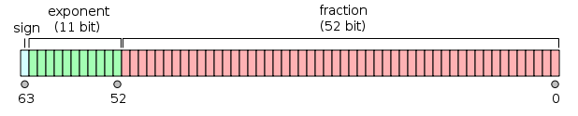
IEEE 754 double-precision binary floating-point format: binary64
This is a commonly used format on PCs.
Sign bit: 1 bit
Exponent width: 11 bits
Significand precision: 53 bits (52 explicitly stored)
This gives from 15–17 significant decimal digits precision. If a decimal string with at most 15 significant digits is converted to IEEE 754 double precision representation and then converted back to a string with the same number of significant digits, then the final string should match the original.

Slide 12
Notes on floating point numbers:
Overflow / Underflow
very small and very large numbers can not be represented using a fixed-length mantissa/exponent representation, therefore overflow and underflow can occur while doing arithmetic with these numbers.
The interval between representable numbers increases as the numbers grow in magnitude and similarly, the round-off error.

